Slide 1

How To Convince Your Boss To Rewrite the App
In this session, we'll talk about the pot of gold at the end of the rewrite rainbow (or lack thereof) in the context of web applications. Developers are always looking for ways to leverage the latest and greatest, and your boss needs to know how this can benefit the bottom line. Let’s get into the details, weigh the pros and cons, and discuss several approaches that might make it possible.

Slide 2


Slide 3

TITLE SPONSORS
TRACK SPONSORS

Slide 4
headline SPONSORS
partner SPONSORS
member SPONSORS
AutoDesk
Bradford, ltd
CenturyLink
City & County of Denver, OED
Colorado House of Pod
The Commons On Champa
Cooley
DCPA - Seawell Ballroom
eTuk Ride
General Assembly
Hired.com
Husch Blackwell
ImageSeller
Intelivideo
Luna Gourmet Coffee & Tea
Mass FX Media
Nanno
Netsuite
Nordstrom
OfficeScapes
The Passport Program
Peak Beverage
Perficient
Slalom Consulting
Spectrum
Test Double
Verizon Wireless
Workiva
Xactly
Zayo
Granicus
Hogan Lovells
Meyer Law
Photomadic
Slifer Smith & Frampton
Swiftpage

Slide 5
V6
Tendril delivers personalized energy experiences for
consumers around the world.
Notes:
Tendril delivers personalized energy experiences for consumers around the world.

Slide 6

Pete Jeffryes
petej.org
pete.topleft@gmail.com
Twitter: @topleftdev
Github: @topleft
https://github.com/topleft/rewrite_talk

Slide 7
How To Convince Your Boss To Rewrite the App
Notes:
This talk a will last about 40 min and then if there are any questions I’d be happy to take those at the end.
In this session we are going to
cover some ideas about perspective
define some terms and give some context around why companies might be considering a rewrite,
Go over a couple strategies for accessing an application and approaching your boss or team
And finally zoom out and look at the timeline of a rewrite
We probably have some managers in the room, we probably have some engineers … and we almost certainly have some tech debt in our lives
This talk is about the conversation between engineer and manager as they work through a problematic application in an effort to achieve their companies greater goals, which usually end in making more money.
So if we agree that both the manager and engineer have the same end goal of creating value for the business, then we can start to look at each of their perspectives and how they might approach a broken application.
What might be an engineers perspective on a problematic app?

Slide 8
Engineer: “Create a better foundation and we can fly through new features!”
Notes:
The engineer sees in the code what is the team back: tightly coupled code, poorly designed schemas, rocky architecture, etc.
So what is the manager’s response?

Slide 9
Manager: “Rewrites are risky, how do I know this is going to work out?”
Notes:
The manager is looking at the big picture, maybe less optimistically than the engineer at the possible out comes of a rewrite. This person is not wading through code everyday and not constantly confronted the spaghetti that is the application, but instead looking at the team goals and lining those up with available resources, prioritizing work. But that is not to say they do not share the goal of stability and velocity with the engineer.
Opportunity costs.

Slide 10

Perspective

Slide 11
The Question: Replace vs Repair?
Notes:
The question here is: When does software become sufficiently costly to maintain that it is more economic to replace (rewrite) it than
to repair (maintain) it?
Define rewrite: create a new application from scratch. Old code is a guide, offers direction for requirements, but no code is used. It is a somewhat drastic measure. Asking this question indicates that the application is broken and needs a lot of help to get on track.
(Avoid the term refactor, stick to repair)
Lets understand this question from both perspectives, engineer and manager while we walk through a few scenarios of how a company might have arrived at the question of a rewrite.

Slide 12
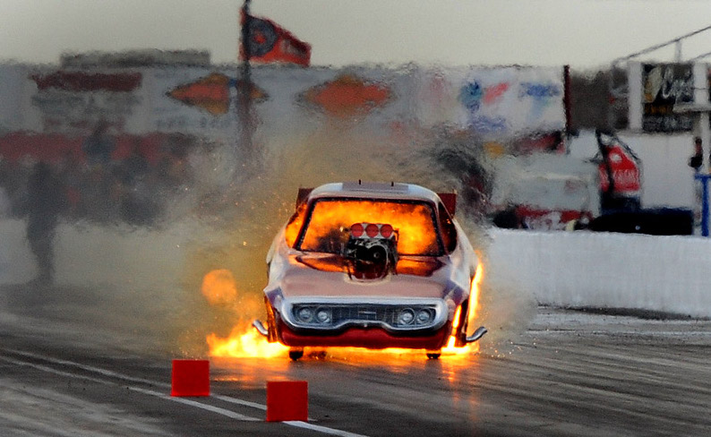
Scenario #1: Young Startup with a Young Team
Notes:
Needs image
- Working application with growing customer base
- Several pivots in the process of getting to market
- Fast moving development in effort to capture opportunity
- Very tightly Coupled code
Inexperienced team
Too many features
Perspective of the developer and the manager
Manager: We need to drill down on the problem areas that are affecting the core services and go from there, or to get customers in the door, we promised some customer development, that’s next on the list.
Dev: There is so much spaghetti here and now that we actually know what our core offerings are, lets start fresh.

Slide 13
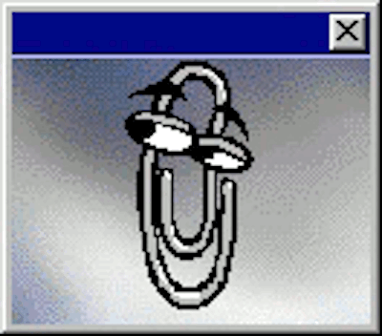
Scenario #2: Legacy Application
Notes:
- A real success, many customers, unique problems solved
- Years of profit, core offering of the company
- Classic/archaic monolith architecture
Need for reliability makes significant improvements difficult/risky
- Hosting costs are significant
Tribal knowledge is high
Finding the right devs / keeping a team is challenging
Manager: I know its hard to read and a little delicate, but that’s years of bug fixes, features requests, problem solving in that app. Super concerned about risk as it is the cash cow.
Dev: If I dig into this thing who knows what is going to break, that’s not on me.

Slide 14

Scenario #3:
API That Can’t Keep Up
Notes:
- Core problems solved, but still much to be desired
- Original estimates of scale were very wrong
- Looming Contract promising 100x growth
Manager: A new language are architecture isn’t going to fix this. We don’t even know what is wrong.
Dev: I can’t figure out what’s wrong, there’s too much noise. We need to simplify this to even have a chance.

Slide 15

The Risks
Rewrites are extremely unpredictable in both timeline and outcome
Missed opportunities
New app, new bugs
Loss of functionality
Customers won’t switch
Run out of capital

Slide 16

The Rewards
Stable platform
Faster feature development
Pay down tech debt
Less bugs
Happy engineers
Notes:
Explain less bugs and happy engineers =→ attract top talent
Less bugs = happy engineers
Better tech = more fruitful environment

Slide 17
What’s an engineer to do?

Slide 18



Diagnose
Measure
Identify
Notes:
I think about this as three steps to success ☺
Here is a break down of a few things you can do to get a better idea of your problem and to be more persuasive in communicating with your boss. Again by taking on their perspective.
What’s wrong with the app?
How can the problem be measured?
How does this help the company accomplish its goals?

Slide 19
What’s Wrong With the App?
Too tightly coupled
Can’t scale
Old tech
Notes:
Too tightly coupled
Everything is always breaking
Hard to isolate bugs
Complexity is off the charts
Can’t scale
Has too many dependencies
Needs too much hardware
Old tech
Can’t keep a quality dev team
Can’t ensure security
Harder to integrate new tech

Slide 20
How can the problem be measured?
Performance Tests
Hosting Costs
Bug Tracking (Jira, Trello, Pivotal Tracker, etc)
Outage and Response
Notes:
Quantify that gut feeling
Often leads to more discovery
Bench marks for comparing to when you actually take on the rewrite
Performance Tests
Is their a single bottle neck? Or several?
Load testing end to end
Hosting Costs
Infrastructure
Data storage
Third party solutions (or lack of)
Bug Tracking (Jira, Trello, Pivotal Tracker, etc)
How many bugs?
How long do they take to fix?
How long do new features take?
Outage and Response
MTBF - mean time between failure
MTTR – meant time to resolve
Outage tools, escalation, on-call tools

Slide 21
How do you help the company accomplish it’s goals?
Capture opportunity
Accrue tech debt wisely
Fix bugs
Identify relevant solutions
Empower development teams
Keep architecture flexible
Notes:
Both of these perspectives, while coming from different angles, have the common goal of creating value for the company. Each group might arrive at value very differently.
These goals can’t all be achieved at the same time, That is the chess game of software development.
How do you help the company accomplish its goals?

Slide 22
How does the company benefit?
Less bugs = more resources
Faster feature delivery
Better security
New business opportunities
Lower hosting costs
More stability = happy customers
Better dev retention and recruitment
Better company culture
Notes:
Mention managers/stakeholders perspective

Slide 23

Collaborate Find Allies and Experts to back you up (or challenge you)

Slide 24
A little more fuel…
Notes:
More features Less Stress, Fear
Happier Customers More Uptime

Slide 25

Cost to replace a developer: $50 to $200+k

Slide 26

Bankrupting the company is also not good for developers

Slide 27
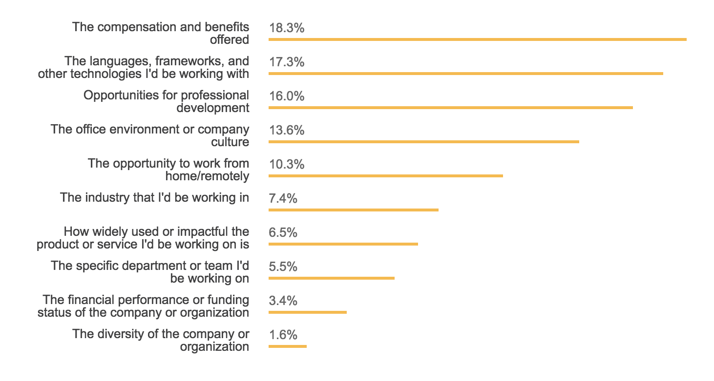
Stack Overflow Survey:
Technology is the #2 priority for accessing new jobs
Notes:
Behind compensation and benefits … tech is the top priority for job seekers

Slide 28
They should generally be avoided in favor of
Refactoring
Creating micro services
Paving a path for modularity
When they are necessary
Have a plan to maintain existing app(s)
Incremental Changes
Confirm customer buy-in
Be honest with yourself…
Rewrites can be a huge decision
Notes:
Rewrites are a huge decision
They should generally be avoided in favor of
Refactoring
Isolating functionality one micro service at a time
Creating a path forward for modularity
When they are necessary
Have a plan to maintain existing app(s)
Deliver value as soon as possible
Incremental Changes
Make sure you have customer buy-in
At all costs???
Write you applications in a way that rewriting is less impactful...
Good test coverage??
Simple services...

Slide 29
You’ve got the thumbs up…now what?

Slide 30


Research: Examples from the Wild
Netscape
Twitter
Failed
Succeeded
Notes:
Learn from others paths, and beware.
Netscape:
3 years to rewrite from scratch, minimal features, poorly tested, rushed the release released buggy code
Major strategic failure
Twitter:
Backend rewrite to Java/Scala – incremental changes, but deep and thorough, almost no rails left on the backend

Slide 31
The big picture
Notes:
More features Less Stress, Fear
Happier Customers More Uptime

Slide 32
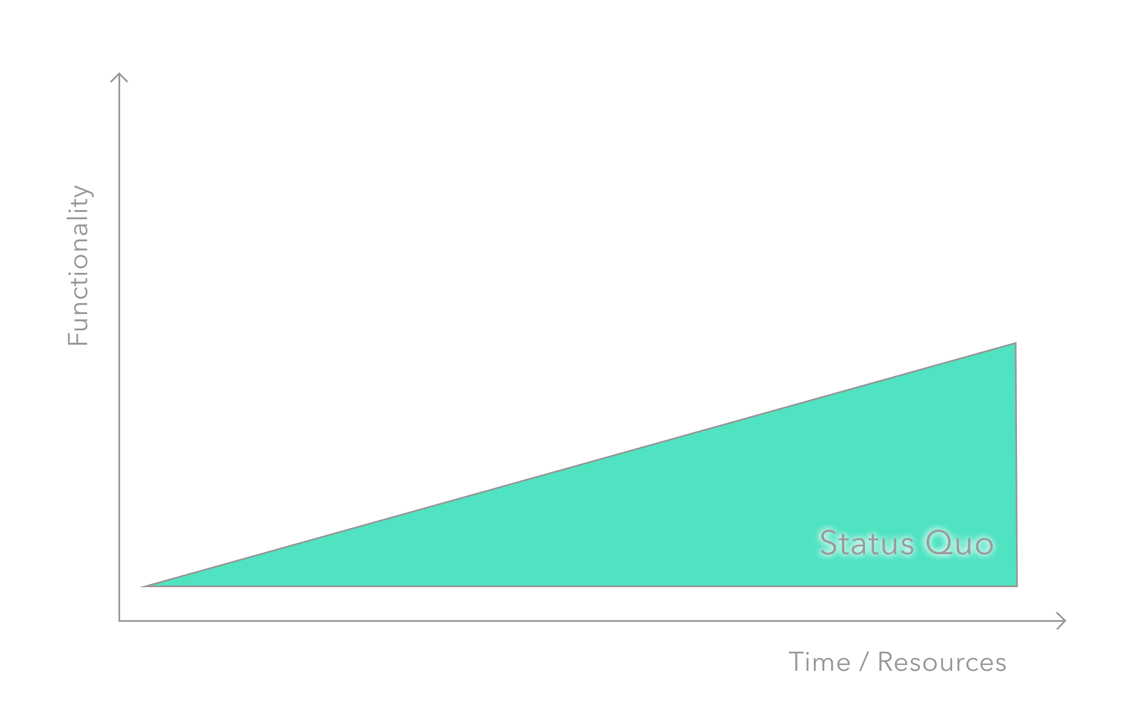
Current Trajectory

Slide 33
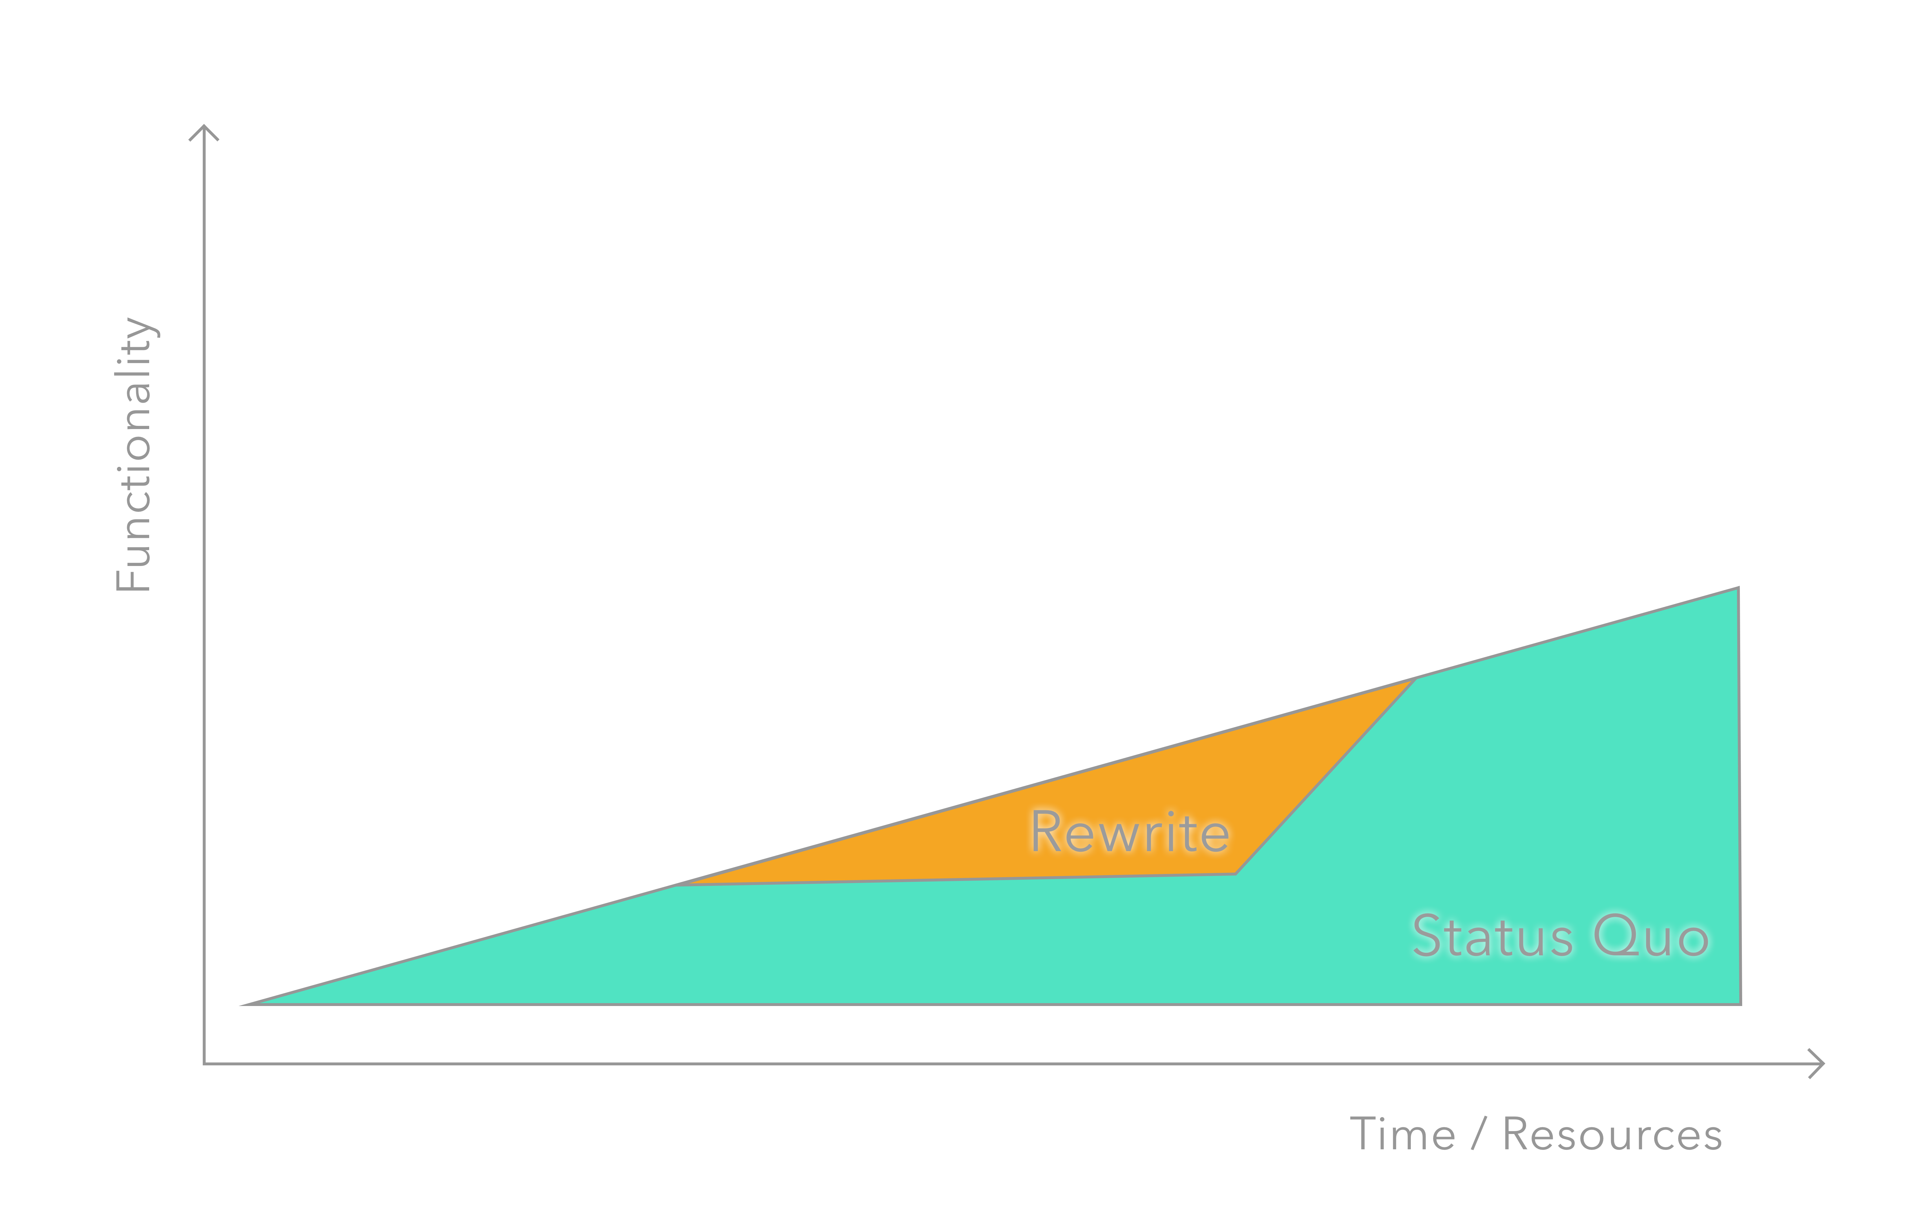
The Rewrite

Slide 34
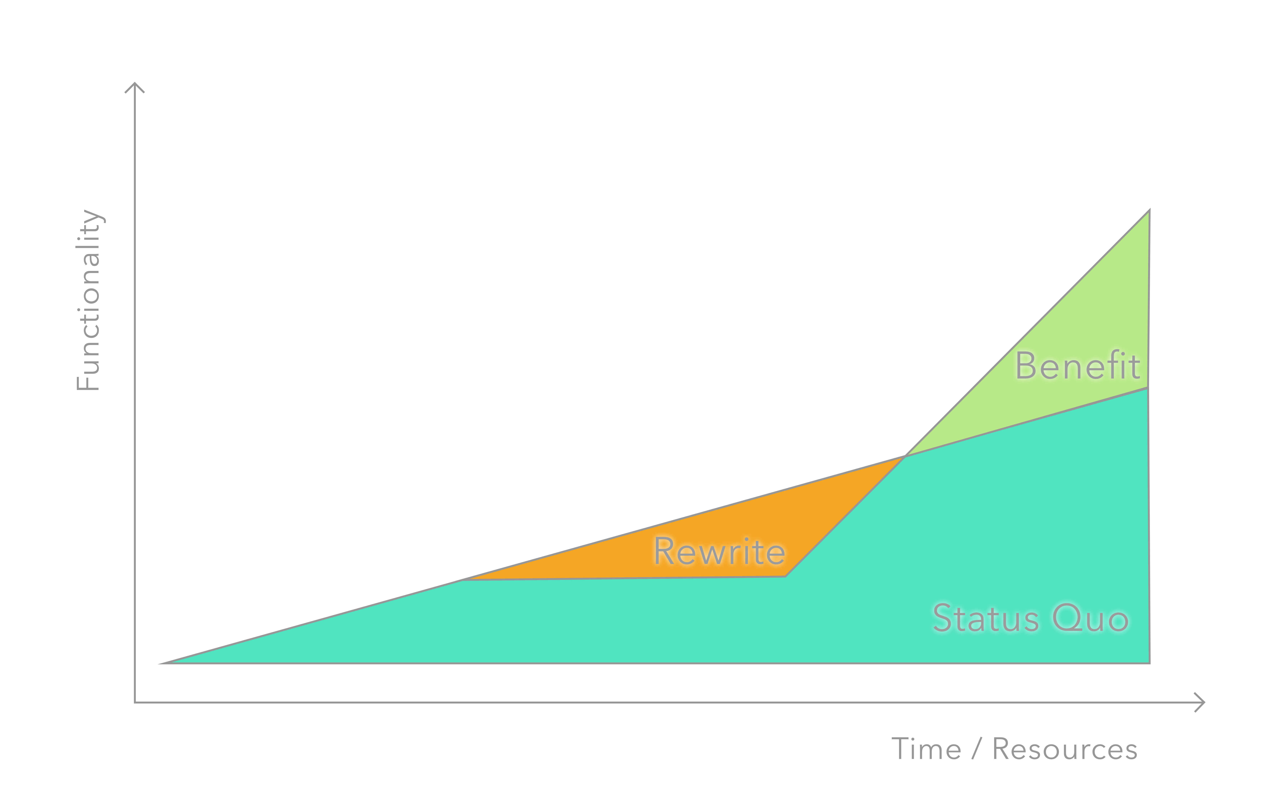
The Benefit

Slide 35
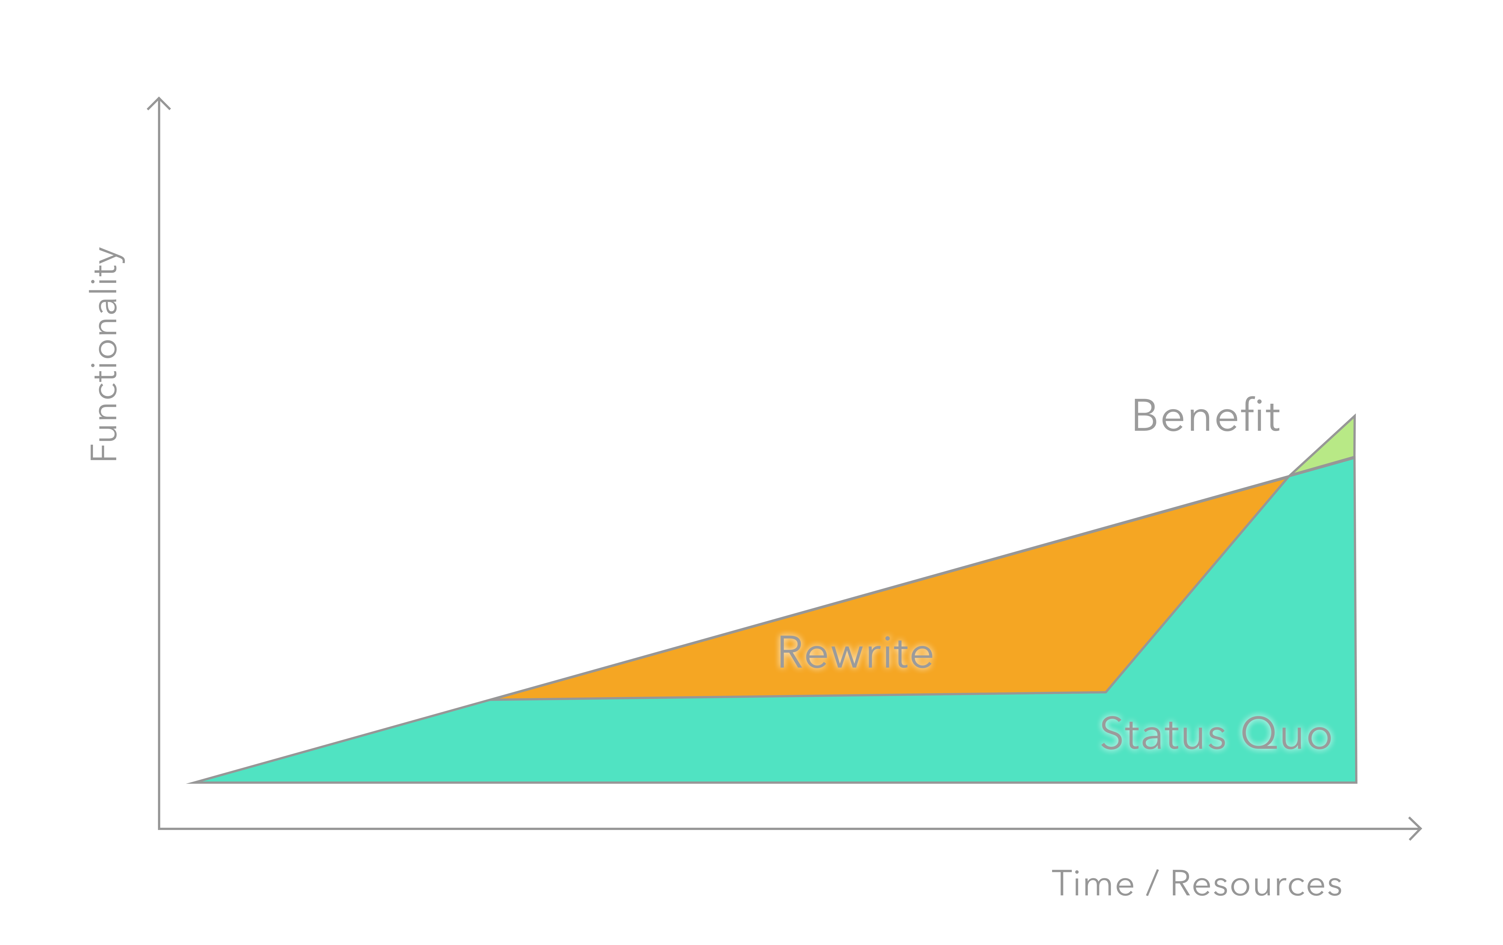
Rewrite takes longer

Slide 36
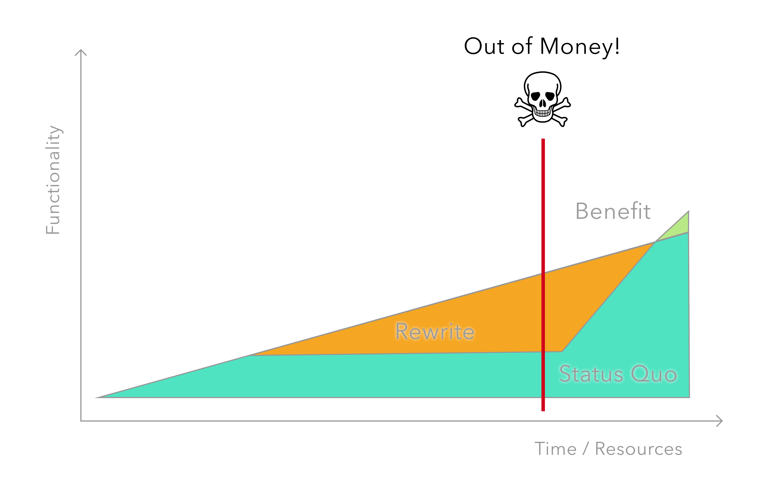
Out of money
Notes:
Out of money or out of customer (missed the opportunity)

Slide 37
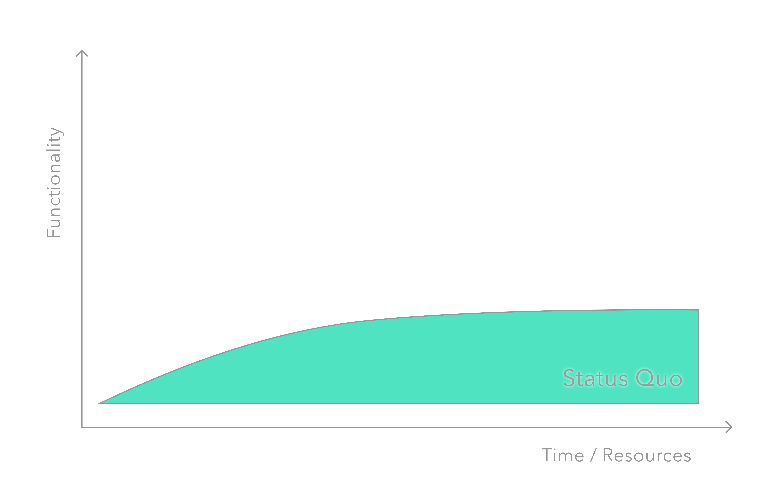
Rewrite Needed

Slide 38

Conclusion
Gain the perspective of your manager
Diagnose, Measure, Identify
Be honest, try to avoid the rewrite if possible
Favor incremental change
Be prepared
Timeline
Budget
Assumed outcome
Notes:
The tree trunk, foundation
New growth

Slide 39
Thanks
Pete Jeffryes
Github: /topleft
Twitter: @topleftdev
pete.topleft@gmail.com
https://github.com/topleft/rewrite_talk
Notes:
We probably have some managers in the room, we probably have some engineers … and we are probably all have some tech debt in our lives
What might be an engineers perspective on rewriting an app?
List engineers perspectives, list some ideas… then switch to next slide
Possibly seed the option of ‘no rewrite’

